Slide 1
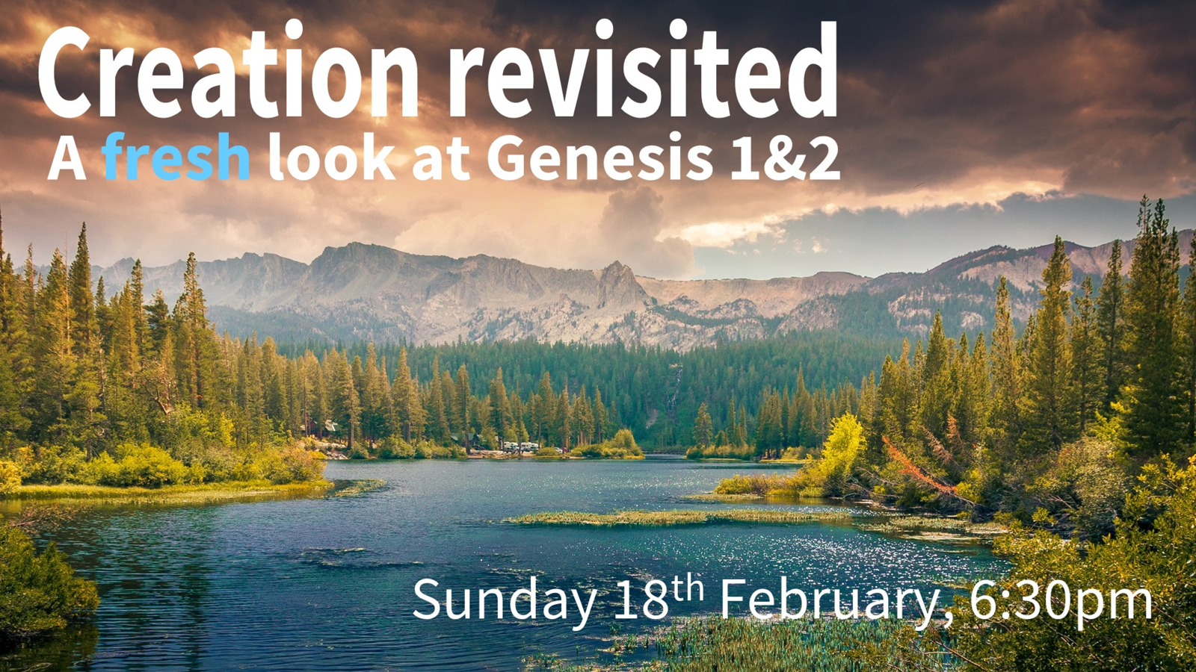

Slide 2
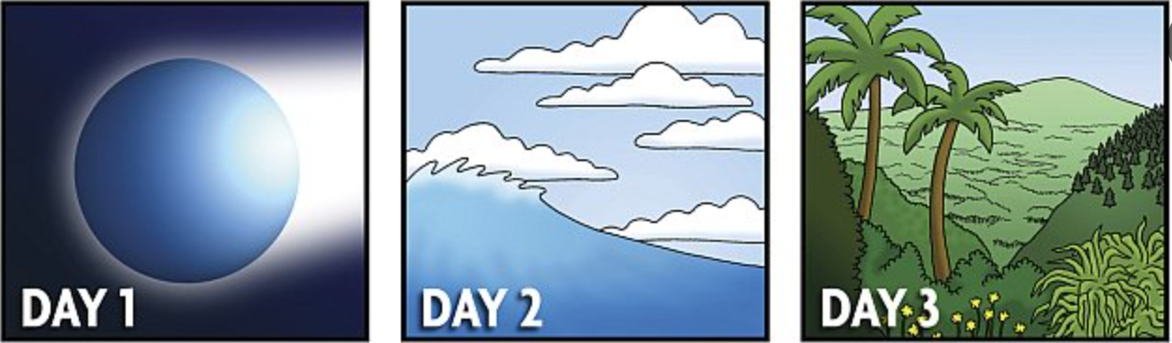
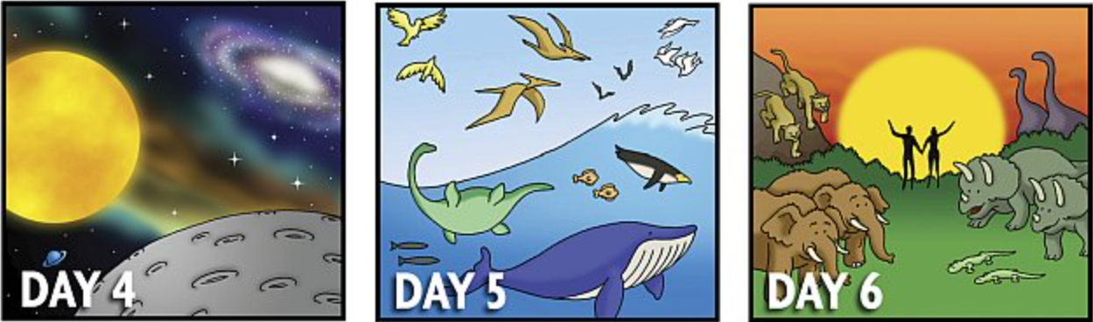
“In the beginning God created the heavens and the earth.
Now the earth was formless and empty, darkness was over the surface of the deep.”
“Darkness”
“Formless”
“Empty”
Creation of Structures, Order,
Realms
Kingdoms.
Formed
Creation of light,
day and night
Creation of sky
and seas
Creation of dry land and plants
“God said”
Populating
those Structures, Realms,
Kingdoms.
Filled
Creation by
His word Col 1.16, Heb 11.3, Jn 1.3
Creation of light sources
Sun, moon, stars
Creation of
birds and fish
Creation of animals
and man

Slide 3
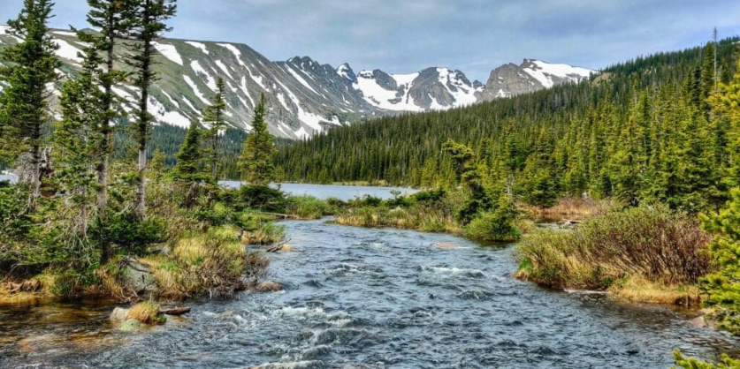
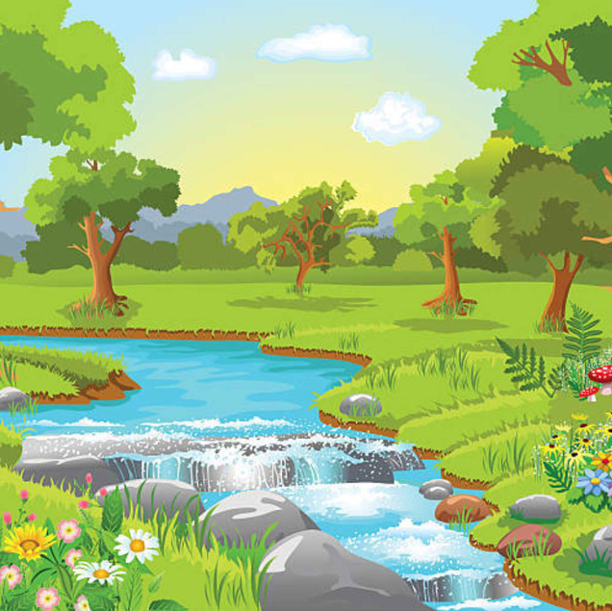

“Now the Lord had planted a garden in Eden”. Gen 2.8
whole earth/land “Planted” garden
“Created” Eden
God gives names Adam gives names
God = “Elohim” “Jehovah Elohim”
Genesis 1-2v4
Genesis 2v5-17
Garden = real place, 4 named rivers, gold, 2 trees, 2 people and clear boundary.
Why is a garden made for Adam and Eve?
Does life in garden differ from life in the rest of the earth?
Is it this garden that most resembles the new earth ?
Is the new earth even something much better?

Slide 4

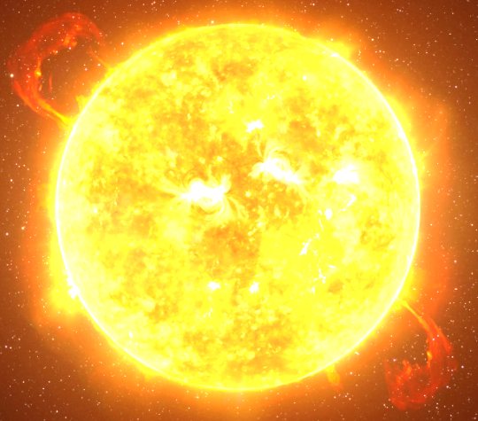
Is “very good” the same as perfect ?
Ps 107.1 “God is good”.
Example of making a chair that perfectly fulfils its purpose.
“We know that in all things God works for the good of those who love Him, who have been called according to His purpose.” Rom 8.28
“You intended to harm me, but God intended it for good to accomplish what is now being done, the saving of many lives.” Gen 50.19
The cross - supreme example of God’s good purpose.
Creation “very good” because perfectly fulfils God’s purpose.
The Earth and Eden - a place of probation not perfection
Earth created In Adam (Law) - New creation is In Christ (Grace)
The forces of nature
are not evil.
Ps 19 Sun =10 billion nuclear explosions / sec = “very good”.

Slide 5

Was there death in the world before the fall?
Did animals, plants, birds, microbes, stars, die before the fall ?
“Therefore, just as sin entered the world through one man, and death through sin, and in this way death came to all people, because all sinned”. Rom 5.12
"one trespass resulted in condemnation for all people" Rom 5:18
and
“For since death came through a man, the resurrection of the dead comes also through a man. For as in Adam all die, so in Christ all will be made alive.” 1 Cor 15.21,22
The “ALL” must refer to mankind only, not all creation.
“For the creation was subjected to frustration, not by its own choice, but by the will of the one who subjected it, in hope that the creation itself will be liberated from its bondage to decay”.
Rom 8 .20
Creation subject to decay and groans = 2nd law of thermodynamics.

Slide 6
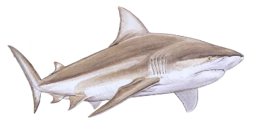

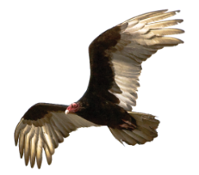
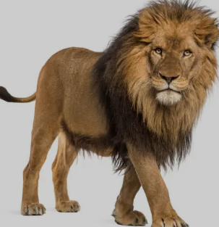
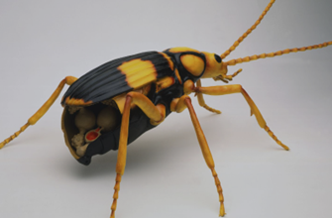
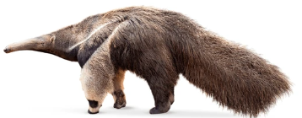
In what way was the “ground cursed”
“Cursed is the ground because of you” . Gen 3.17
The ground ! Not the whole earth, or sea, sky, stars !
Life is harder not utterly different. Increased sweat, pain, labour.
Cast out of garden into the wildness of the world.
No new laws of digestion, metabolism, behaviour.
No new sharks, jellyfish, sea urchins, vultures, eagles, anteaters.
God boasts of His creation in Job 38-41
“Do you hunt prey for the lioness
or food for ravens?” Job 38.39

Slide 7
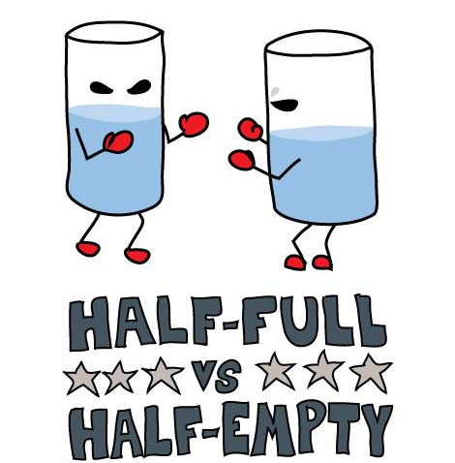
Why is God concerned with what animals eat?
““I give you every seed-bearing plant on the face of the whole earth and every tree that has fruit with seed in it. They will be yours for food. And to all the beasts of the earth and all the birds in the sky and all the creatures that move along the ground—everything that has the breath of life in it—I give every green plant for food.”. Gen 1.30
God’s abundant provision of fruit / vegetables for all life on earth
The test of obedience is all about food.
Not a restriction as to what can be eaten – otherwise another commandment !

Slide 8
The Seventh day
“Six days you shall labour and do (asa) all your work, ……..on it you shall not do (asa) any work….. for in six days the Lord made (asa) the heavens and the earth, the sea, and all that is in them, but He rested on the seventh day. Therefore the Lord blessed the Sabbath day and made it holy.” Ex 20.11
“asa” translated “do” 1500 times in OT
What did the Lord “do” (not “create “- bara) for six days and then stop doing on 7th?
He stopped speaking. He rested !
To give us a pattern for work and rest.
“the sabbath was made for man” Mk 2: 27
The pattern only works if all the days are ordinary 24 hour days.
For six literal 24 hour days God spoke, He revealed His creation of the world.

Slide 9
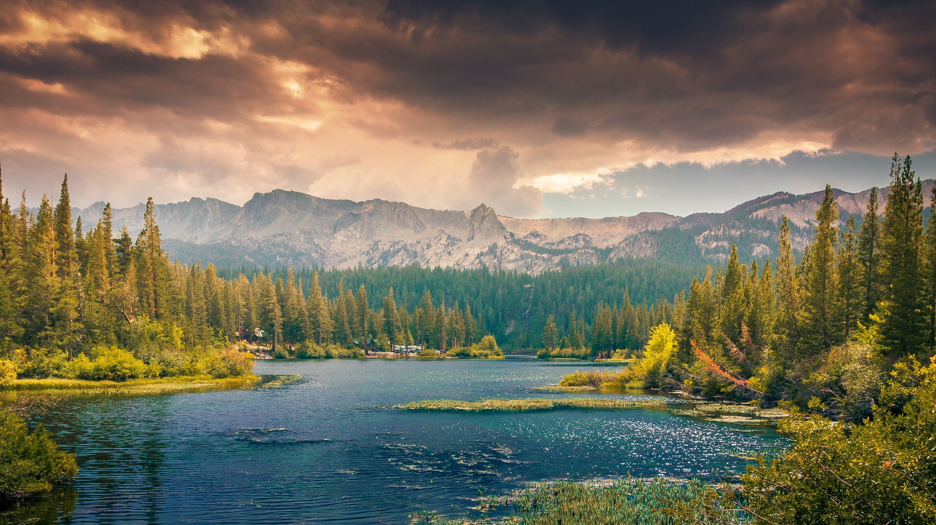

What was new to you?
What did you find most interesting?
What didn’t you understand?
What did you disagree with?

Slide 10
Q&A

