Slide 1

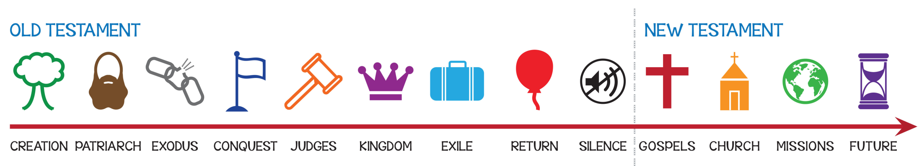
Walk
Bible
through
the
#2 The Making of a Nation

Slide 2
Walk
#2 Making of a Nation
through
the
Bible
Gen 12:1-3 The Lord had said to Abram, “Go from your country, your people and your father’s household to the land I will show you.
I will make you into a great nation,
and I will bless you;
I will make your name great,
and you will be a blessing.
I will bless those who bless you,
and whoever curses you I will curse;
and all peoples on earth
will be blessed through you.”

Slide 3
Walk
#2 Making of a Nation
through
the
Bible
Gen 12:1-3 The Lord had said to Abram, “Go from your country, your people and your father’s household to the land I will show you.
I will make you into a great nation,
and I will bless you;
I will make your name great,
and you will be a blessing.
I will bless those who bless you,
and whoever curses you I will curse;
and all peoples on earth
will be blessed through you.”
Blessing

Slide 4
Walk
#2 Making of a Nation
through
the
Bible
Gen 12:1-3 The Lord had said to Abram, “Go from your country, your people and your father’s household to the land I will show you.
I will make you into a great nation,
and I will bless you;
I will make your name great,
and you will be a blessing.
I will bless those who bless you,
and whoever curses you I will curse;
and all peoples on earth
will be blessed through you.”
Blessing
Nation

Slide 5
Walk
#2 Making of a Nation
through
the
Bible
Gen 12:1-3 The Lord had said to Abram, “Go from your country, your people and your father’s household to the land I will show you.
I will make you into a great nation,
and I will bless you;
I will make your name great,
and you will be a blessing.
I will bless those who bless you,
and whoever curses you I will curse;
and all peoples on earth
will be blessed through you.”
Blessing
Nation
Land

Slide 6

Walk
#2 Making of a Nation
through
the
Bible
Blessing
God
Nation
Land
Abraham
Isaac
Jacob
Nation
12 tribes
Genesis 22:2 Then God said, “Take your son, your only son, whom you love—Isaac—and go to the region of Moriah. Sacrifice him there...”

Slide 7

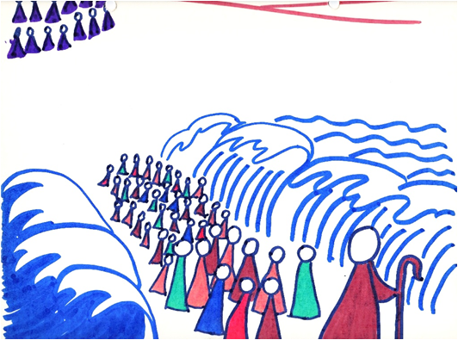

Walk
#2 Making of a Nation
through
the
Bible
Blessing
God
Nation
Land
Abraham
Isaac
Jacob
Substitution – sacrifice
Law never saved
Nation
12 tribes
Numbers 13:1-2 The Lord said to Moses, “Send some men to explore the land of Canaan, which I am giving to the Israelites.”
40 years

Slide 8
Walk
#2 Making of a Nation
through
the
Bible
Blessing
God
Nation
Land
Abraham
Isaac
Jacob
Substitution – sacrifice
Law never saved
Nation
12 tribes
Joshua 24:15 Choose this day who you will serve
40 years

