Slide 1

7
SEVEN
LETTERS
_
_
revelation 2-3
#4 The Church that Tolerated False Teaching

Slide 2

7
SEVEN
#4 The Church that Tolerated False Teaching
Revelation 2:18-29
LETTERS
_
DODGY TEACHER (v20)
I know (v19) nothing is hidden from Jesus Hebrews 4:13
5 great things about this church (v19)...
Love
Service
More than at first
Faith
Perseverance

Slide 3
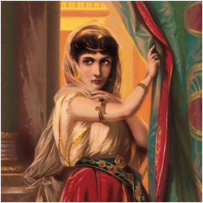
7
SEVEN
#4 The Church that Tolerated False Teaching
Revelation 2:18-29
LETTERS
_
Elijah’s arch-enemy
Married to Ahab (one of the worst men!)
Witchcraft – Baal
Supported prophets of Baal
Murderer
Jezebel: nastiest woman in the Bible?
She lead people away from God towards evil.

Slide 4
7
SEVEN
#4 The Church that Tolerated False Teaching
Revelation 2:18-29
LETTERS
_
They tolerated someone who was leading people away from God towards evil.
She’s a self-proclaimed “prophet” (v20)
    1Corinthians 14:29, 1Thessalonians 5:20
She led the people into sexual immorality, idolatry (v20)
But God showed grace towards her...for a time (v21-22)
How can this ever happen in a church???
Why rock the boat? Church is “doing well”.

Slide 5
7
SEVEN
#4 The Church that Tolerated False Teaching
Revelation 2:18-29
LETTERS
_
  Teachers:
  James 3:1 Not many of you should become teachers, my fellow believers, because you know that we who teach will be judged more strictly
  Church:
  2Timothy 4:3 the time will come when people will not put up with sound doctrine. Instead, to suit their own desires, they will gather around them a great number of teachers to say what their itching ears want to hear.
  Encouragement: Hold on to Jesus (v24-25)

