Slide 1

7
SEVEN
LETTERS
_
_
revelation 2-3
#2 The Church that Suffered

Slide 2
7
SEVEN
#2 The Church that Suffered Revelation 2:8-11
LETTERS
_
Win!
Mark 9:35 Anyone who wants to be first must be the very last, and the servant of all.

Slide 3
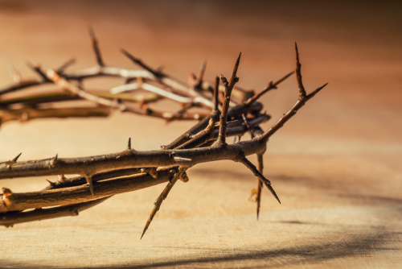
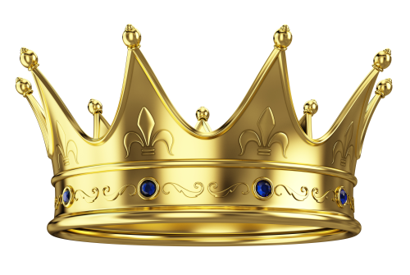
7
SEVEN
#2 The Church that Suffered Revelation 2:8-11
LETTERS
_
Chapter 1 sets the context for the 7 letters:
Revelation 1:9
I, John, your brother and companion in the suffering and kingdom and patient endurance that are ours in Jesus...
Patient endurance

Slide 4
7
SEVEN
#2 The Church that Suffered Revelation 2:8-11
LETTERS
_
Suffering was real for the church in Smyrna:
Affliction (v9)
Poverty (v9)
Slander (v9)
Prison, persecution, death (v10)
Jesus’ encouragements to them:
Jesus has the “long view” (v8)
Jesus has defeated the greatest enemy (v8)
Jesus knows (v9, twice)
Faithfulness now will be rewarded later (v9,10)

Slide 5
7
SEVEN
#2 The Church that Suffered Revelation 2:8-11
LETTERS
_
2Corinthians 4:17 our light and momentary troubles are achieving for us an eternal glory that far outweighs them all.

Slide 6
7
SEVEN
#2 The Church that Suffered Revelation 2:8-11
LETTERS
_
Suffering was real for the church in Smyrna:
Affliction (v9)
Poverty (v9)
Slander (v9)
Prison, persecution, death (v10)
Jesus’ encouragements to them:
Jesus has the “long view” (v8)
Jesus has defeated the greatest enemy (v8)
Jesus knows
Faithfulness now will be rewarded later (v9,10)
They will be safe for eternity, with Jesus (v11)

Slide 7
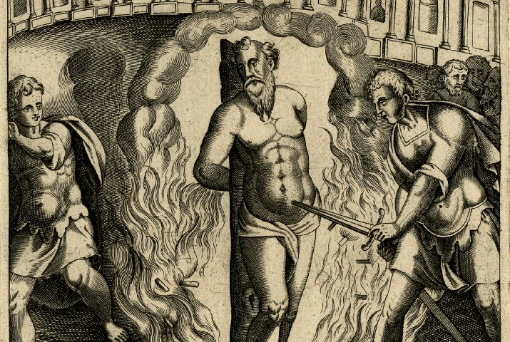
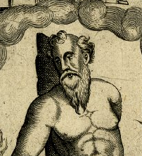
7
SEVEN
#2 The Church that Suffered Revelation 2:8-11
LETTERS
_
Polycarp, Bishop of Smyrna

Slide 8
7
SEVEN
#2 The Church that Suffered Revelation 2:8-11
LETTERS
_
So...
...do not be afraid (v10)
...be faithful (v10)
...shine! (Matthew 5:15)
...do what Jesus did:
  Hebrews 12:2-3 Jesus, [who] ... for the joy set before him he endured the cross, scorning its shame, and sat down at the right hand of the throne of God.
  Consider him who endured such opposition from sinners, so that you will not grow weary and lose heart.

