Slide 1
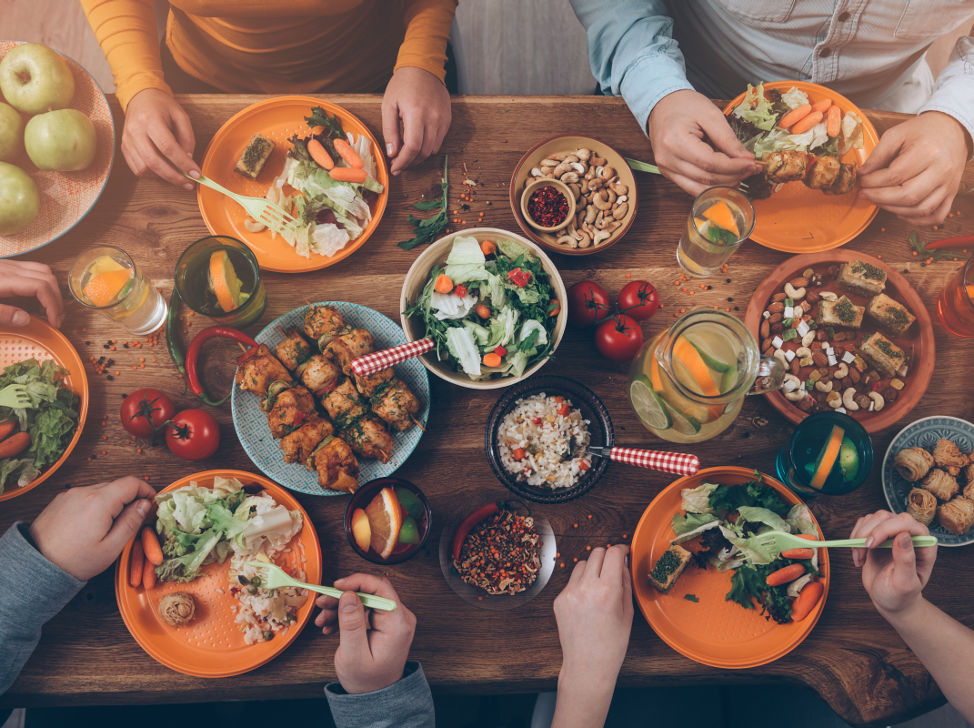
Mealtimes
with the
Messiah
#11 BBQ on the Beach
(John 21:1-14)

Slide 2
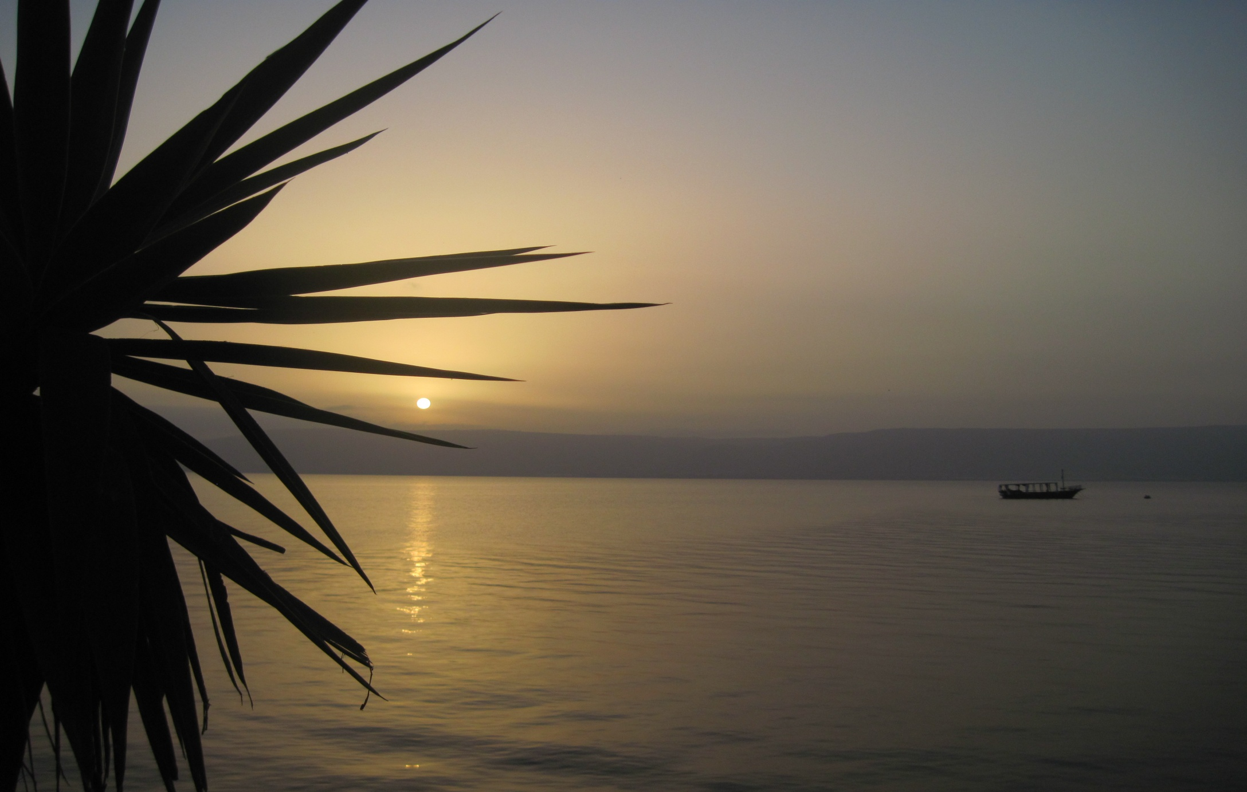
Mealtimes
#11 BBQ on the Beach
(John 21:1-14)
Messiah
with the

Slide 3
Mealtimes
#11 BBQ on the Beach
(John 21:1-14)
Messiah
with the
#1 Spend time with Jesus (v1)
#2 Depend on Jesus (v3-5)
#3 Recognise Jesus in your circumstances (v6)

Slide 4
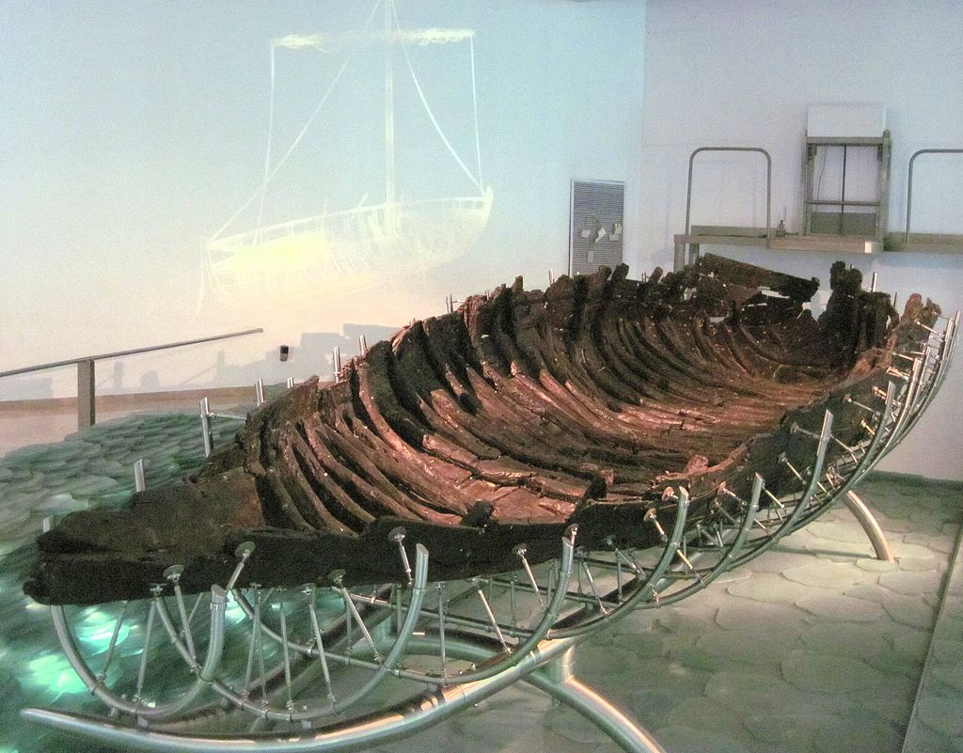
Mealtimes
#11 BBQ on the Beach
(John 21:1-14)
Messiah
with the

Slide 5
Mealtimes
#11 BBQ on the Beach
(John 21:1-14)
Messiah
with the
#1 Spend time with Jesus (v1)
#2 Depend on Jesus (v3-5)
#3 Recognise Jesus in your circumstances (v6)
#4 Honour Jesus in other people (v7)
#5 Partner with Jesus (v8-11)

