Slide 1
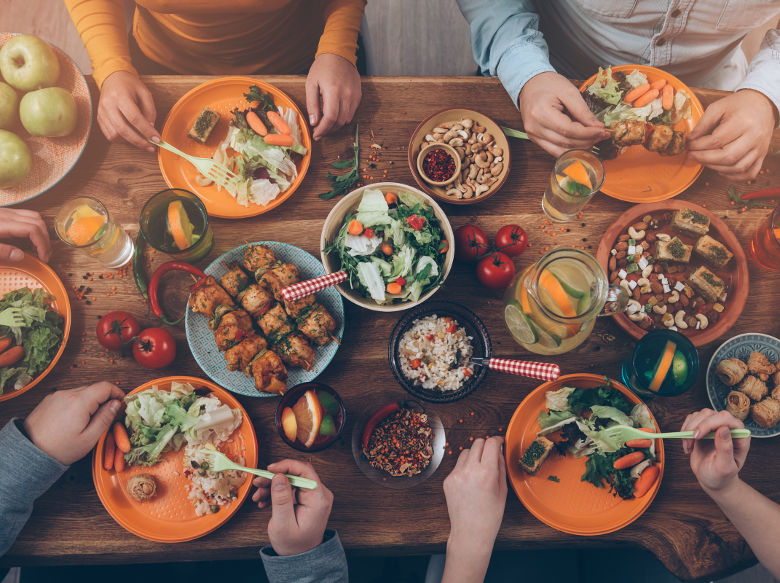
Mealtimes
with the
Messiah
#6 Mass Catering
(Mark 8:1-21)

Slide 2
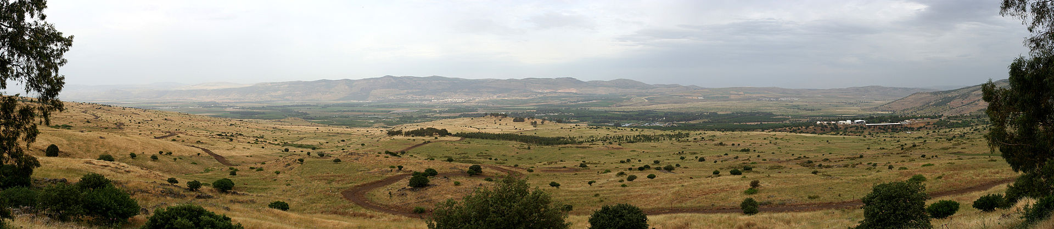
Mealtimes
#6 Mass Catering
(Mark 8:1-21)
Messiah
with the
Matthew 15:30-31 Great crowds came to him ... the blind, the crippled, the mute and many others ... and he healed them... they saw the mute speaking, the crippled made well, the lame walking and the blind seeing.
Jesus’ response to a hungry crowd with (almost) no food:
Compassion (v2)

Slide 3
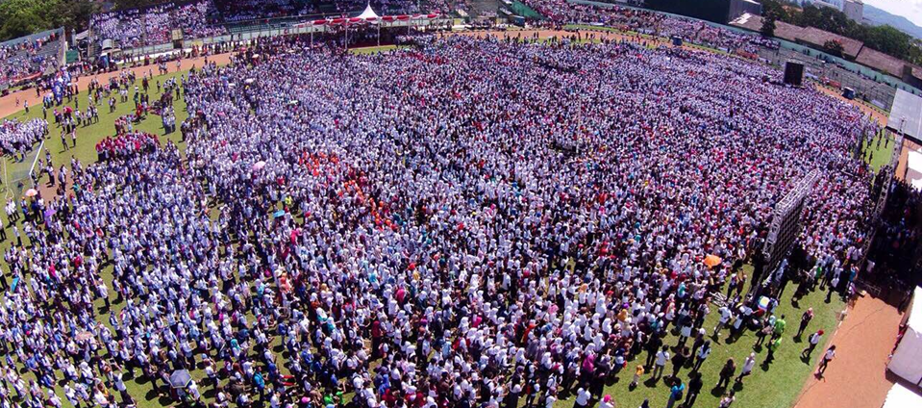
Mealtimes
#6 Mass Catering
(Mark 8:1-21)
Messiah
with the
Jesus’ response to a hungry crowd with (almost) no food:
Compassion (v2)
Grateful to God for what little they had (v6,7)

Slide 4
Mealtimes
#6 Mass Catering
(Mark 8:1-21)
Messiah
with the
The Pharisees’ blindness:
They wanted a sign – (ANOTHER one!) (v11)
  2Corinthians 4:4 The god of this age has blinded the minds of unbelievers, so that they cannot see the light of the gospel that displays the glory of Christ
  2Corinthians 4:6 [God...] made his light shine in our hearts to give us the light of the knowledge of God’s glory displayed in the face of Christ.
  Only the gospel of Jesus can un-blind people.

Slide 5
Mealtimes
#6 Mass Catering
(Mark 8:1-21)
Messiah
with the
The Disciples’ temporary blindness:
Fixated by lunch (v13-16)
  How have they forgotten so quickly? (v17-21)
  They’ve forgotten to learn from Jesus’ past faithfulness to them.

