Slide 1
#4 – Joseph’s Story
Genesis 42:1-24

Slide 2

#4 – Joseph’s Story Genesis 42:1-24
James 1:20 …anger does not bring about the righteous life that God desires.

Slide 3

#4 – Joseph’s Story Genesis 42:1-24
Ephesians 4:32 ...forgive each other, just as in Christ God forgave you.

Slide 4

#4 – Joseph’s Story Genesis 42:1-24
Genesis 42:17 And he put them all in custody for three days.

Slide 5

#4 – Joseph’s Story Genesis 42:1-24
Genesis 42:18-19 On the third day, Joseph said to them, "Do this and you will live, for I fear God...

Slide 6
#4 – Joseph’s Story Genesis 42:1-24
Ephesians 4:32 Be kind and compassionate to one another, forgiving each other, just as in Christ God forgave you.

Slide 7
#4 – Joseph’s Story Genesis 42:1-24
He does not take revenge

Slide 8
#4 – Joseph’s Story Genesis 42:1-24
He does not take revenge
Shows practical love to his brothers

Slide 9
#4 – Joseph’s Story Genesis 42:1-24
He does not take revenge
Shows practical love to his brothers
He aims high, wisely

Slide 10
#4 – Joseph’s Story Genesis 42:1-24
He does not take revenge
Shows practical love to his brothers
He aims high, wisely
Talks to them, alone
Genesis 45:1 Then Joseph could no longer control himself before all his attendants, and he cried out, "Make everyone leave my presence!" So there was no-one with Joseph when he made himself known to his brothers.

Slide 11
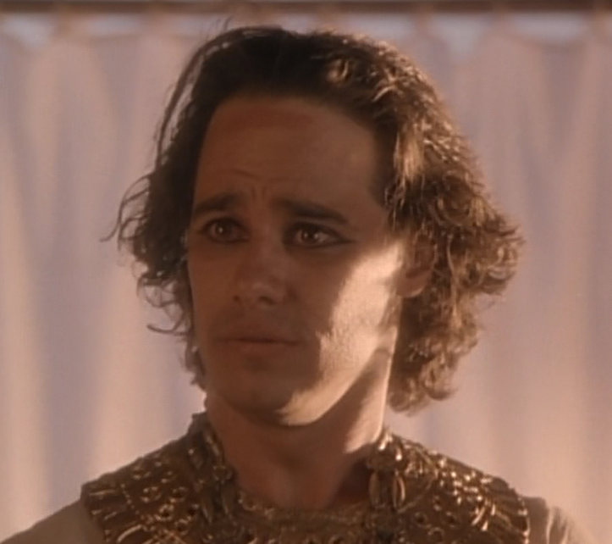
#4 – Joseph’s Story Genesis 42:1-24
He does not take revenge
Shows practical love to his brothers
He aims high, wisely
Talks to them, alone
“I am Joseph...”

Slide 12
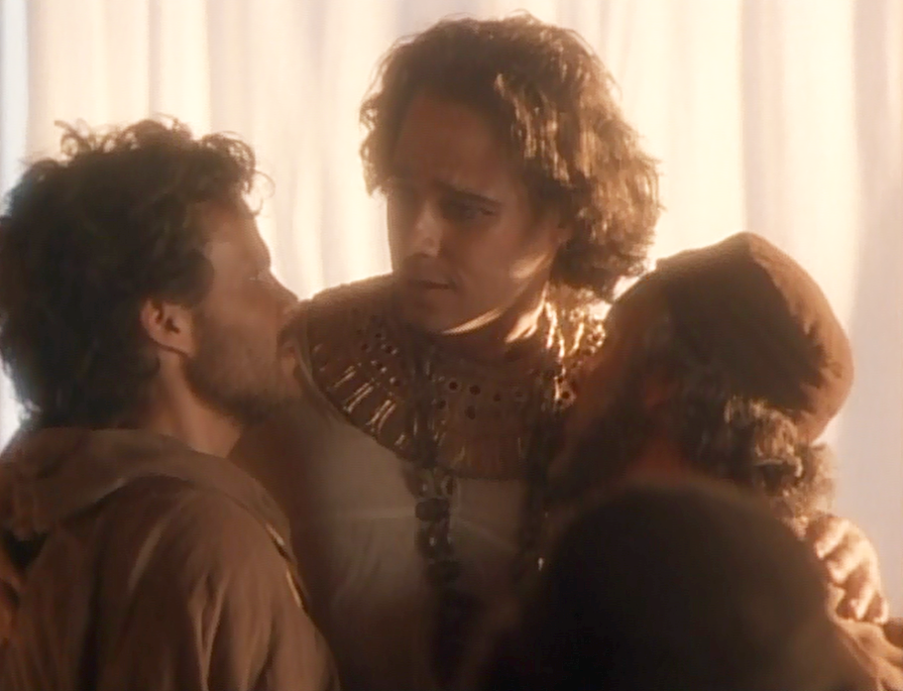
#4 – Joseph’s Story Genesis 42:1-24
He does not take revenge
Shows practical love to his brothers
He aims high, wisely
Talks to them, alone
“Come close to me...”

Slide 13
#4 – Joseph’s Story Genesis 42:1-24
He does not take revenge
Shows practical love to his brothers
He aims high, wisely
Talks to them, alone
Doesn’t minimise what they’ve done, but forgives anyway
Genesis 45:4 ... "I am your brother Joseph, the one you sold into Egypt!”

Slide 14
#4 – Joseph’s Story Genesis 42:1-24
He does not take revenge
Shows practical love to his brothers
He aims high, wisely
Talks to them, alone
Doesn’t minimise what they’ve done, but forgives anyway
Does good to them
Genesis 45:18 I will give you the best of the land of Egypt and you can enjoy the fat of the land.'

Slide 15
#4 – Joseph’s Story Genesis 42:1-24
He does not take revenge
Shows practical love to his brothers
He aims high, wisely
Talks to them, alone
Doesn’t minimise what they’ve done, but forgives anyway
Does good to them
Remembers God is in control
Genesis 45:5 … it was to save lives that God sent me ahead of you.
Genesis 50:20 You intended to harm me, but God intended it for good to accomplish what is now being done, the saving of many lives.

