Slide 1
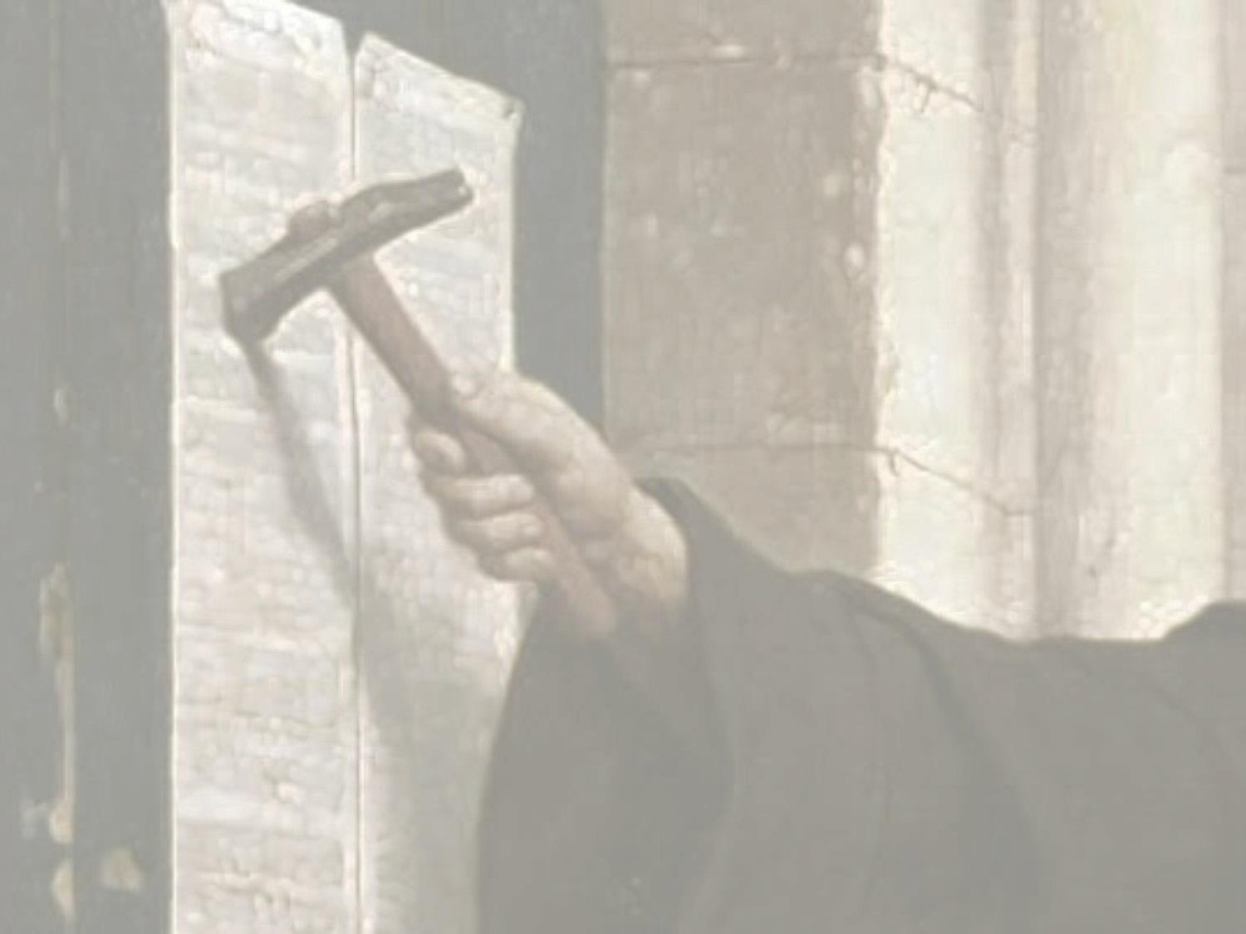
Martin Luther-The monk who discovered Grace
“For in the gospel a righteousness from God is revealed, a righteousness that is by faith from first to last, just as it is written: "The righteous will live by faith. The wrath of God is being revealed from heaven against all the godlessness and wickedness of men”.
Romans 1:17

Slide 2
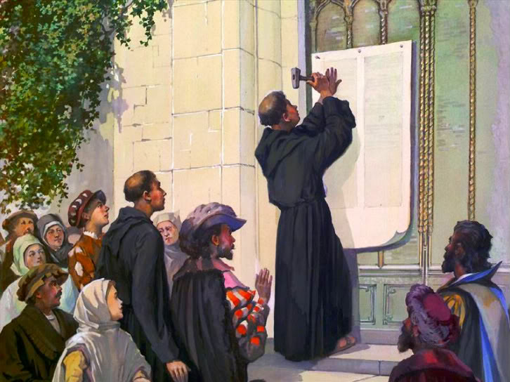
Martin Luther-The monk who discovered Grace
Tuesday, October 31, 1517

Slide 3
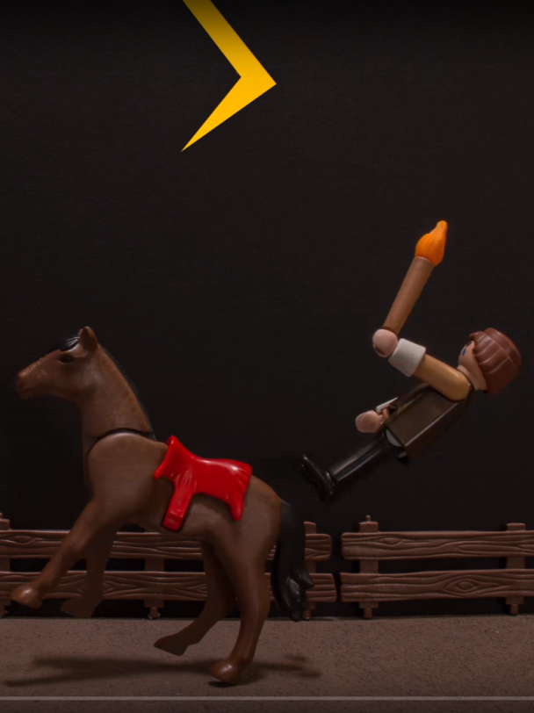
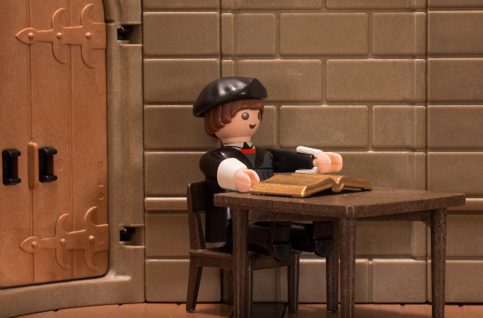
Martin Luther-The monk who discovered Grace
“ From childhood on I turned pale when I heard the name of Christ, for I was taught only to see Him as a strict and fearful judge.”
Prayed to Mary and St Anne to save him. He became a monk.
"If anyone could have earned heaven by the life of a monk, it was I. If I had kept going I would have killed myself."

Slide 4
Martin Luther-The monk who discovered Grace
“For in the gospel a righteousness from God is revealed, a righteousness that is by faith from first to last, just as it is written: "The righteous will live by faith. The wrath of God is being revealed from heaven against all the godlessness and wickedness of men”.
Romans 1:17
"“I hated that word “the righteousness of God“, the harder I tried to be righteous the more I failed.
The more I realised I was unrighteous and could not live by faith.”

Slide 5
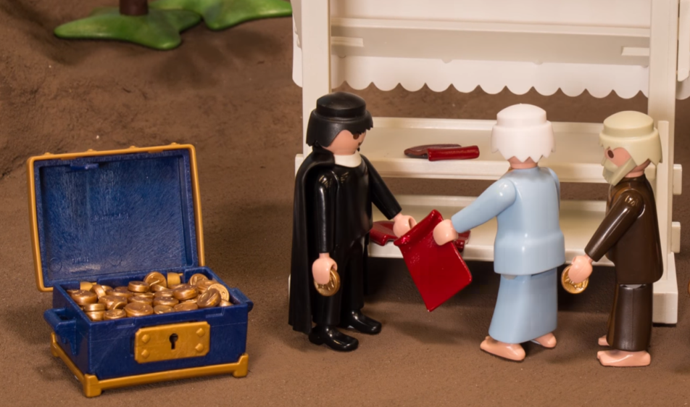
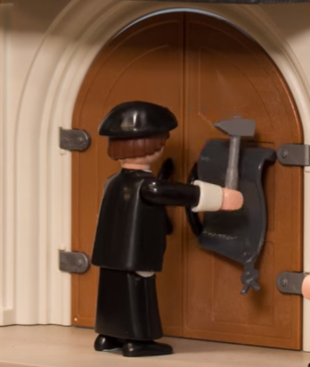
Martin Luther-The monk who discovered Grace
Johann Tetzel sold indulgences that promised forgiveness
"Once the coin into the coffer clings, a soul from purgatory heavenward springs!"
Theses No.1
“ When our Lord and Master, Jesus Christ, says "Repent " He doesn’t mean “Do penance” but He means that the entire life of the faithful should be one of repentance.”

Slide 6
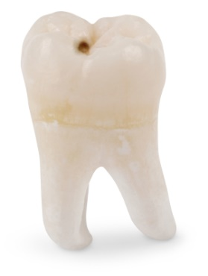

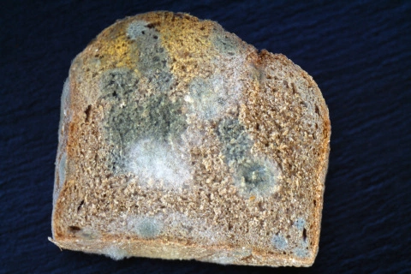
Martin Luther-The monk who discovered Grace
Castle church at Wittenberg, 31st Oct 1517
Eve of All Saints Day (All Hallows day)
Over 5000 Relics on display

Slide 7
Martin Luther-The monk who discovered Grace
“For in the gospel a righteousness from God is revealed, a righteousness that is by faith from first to last, just as it is written: "The righteous will live by faith. The wrath of God is being revealed from heaven against all the godlessness and wickedness of men”.
Romans 1:17
“I began to understand that the righteousness of God is a gift from God that comes through faith alone, and that this righteousness is revealed by the gospel.”
“Here I felt as if I were entirely born again and had entered paradise itself through the gates that had been flung open.”
Luther’s sermon - “Two kinds of righteousness.”
- The joyful exchange

Slide 8
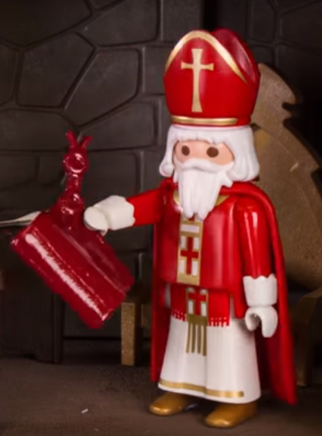
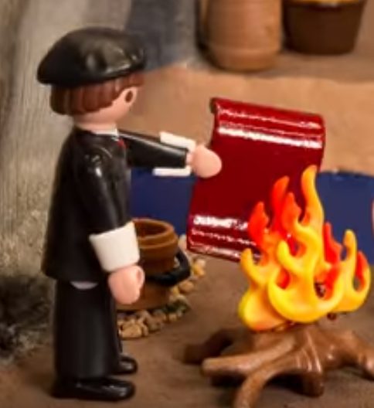
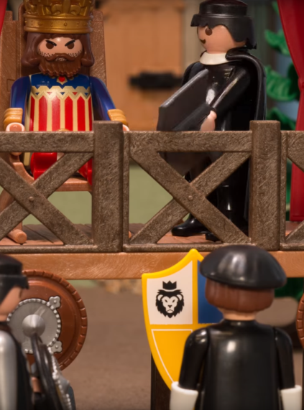
Martin Luther-The monk who discovered Grace
Pope Leo sent Luther a letter threatening
excommunication.
Luther burnt the letter and
announced the Pope as
the Antichrist.
"To God’s Word will I remain true, though the
whole world be against me. Here I stand. I can
do no other. God help me!"

Slide 9
Martin Luther-The monk who discovered Grace
1) Luther discovered “Grace alone, through faith alone”
By nature we are incurably committed to salvation by “works”.
God says “all our righteous works are like filthy rags". Is 64.6
“For it is by grace you have been saved, through faith -- not by works, so that no-one can boast.” Eph 2.9
2) Luther discovered “Faith is trusting Jesus only”.
Abandonment to Jesus secures our salvation.
Anything less is an insult to Jesus’ work on the cross.
“Nothing in my hand I bring, simply to your cross I cling”

