Slide 1
3 Reasons to Rejoice this Christmas
Luke 1:46-55

Slide 2
3 Reasons to Rejoice this Christmas
Luke 1:46-55
“Joy: A deep feeling or condition of happiness or contentment”

Slide 3
3 Reasons to Rejoice this Christmas
Luke 1:46-55
God is faithful to his promises (v54-55)

Slide 4
3 Reasons to Rejoice this Christmas
Luke 1:46-55
God is faithful to his promises (v54-55)
God is merciful to humble people (v50-53)

Slide 5
3 Reasons to Rejoice this Christmas
Luke 1:46-55
God is faithful to his promises (v54-55)
God is merciful to humble people (v50-53)
God has moved in my life (v47-49)

Slide 6
3 Reasons to Rejoice this Christmas
Luke 1:46-55
God is faithful to his promises (v54-55)
God is merciful to humble people (v50-53)
God has moved in my life (v47-49)

Slide 7
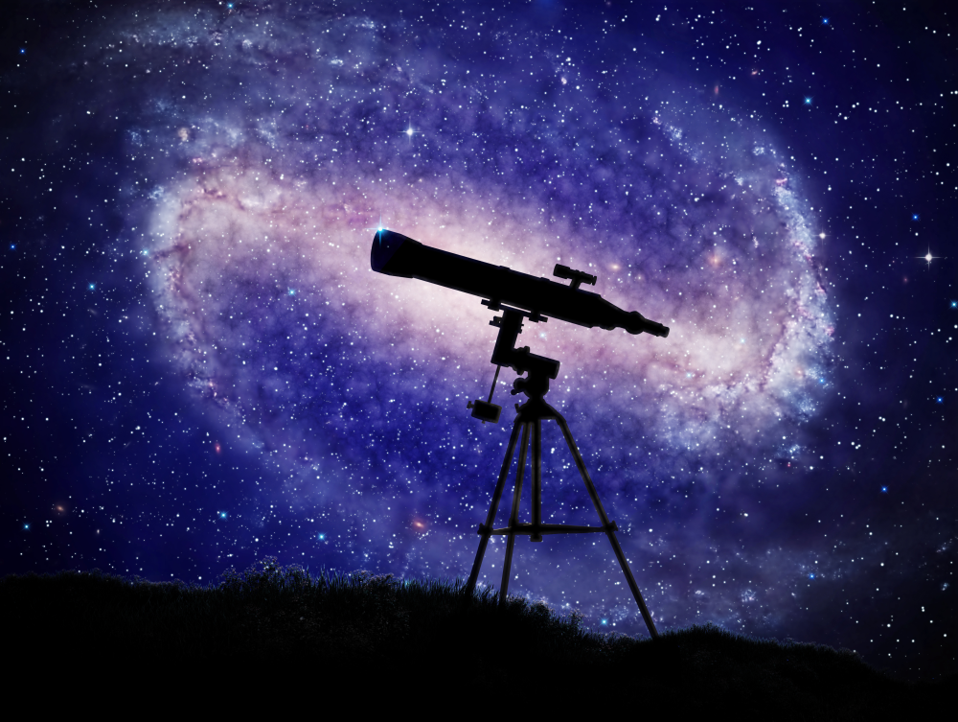
3 Reasons to Rejoice this Christmas
Luke 1:46-55
My soul magnifies the Lord (v46)

