Slide 1
mess
y
church
The message of 1Corinthians for today
#4 The Foolishness of Christianity 1Corinthians 1:17 – 2:5

Slide 2
#4 The Foolishness of Christianity
1Corinthians 1:17 – 2:5
mess
y
church
The Foolishness of the cross (v17-25)
What do you see at the cross?
For the Christian, it’s the power of God (v18)
The Jews saw it as weakness – a stumbling block (v23)
The Greeks saw it as foolishness (v23)
  Don’t try to make it less foolish!

Slide 3
#4 The Foolishness of Christianity
1Corinthians 1:17 – 2:5
mess
y
church
The Foolishness of the cross (v17-25)
The Foolishness of the people God chooses (v26-31)
He chooses “ordinary” people (v26)
Jesus lived as an “ordinary” person
Why? So no-one can boast (v27,29)
What are you tempted to boast about?

Slide 4
#4 The Foolishness of Christianity
1Corinthians 1:17 – 2:5
mess
y
church
The Foolishness of the cross (v17-25)
The Foolishness of the people God chooses (v26-31)
The Foolishness of Preaching (2:1-5)

Slide 5
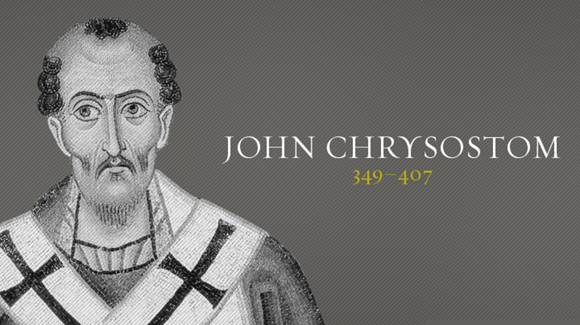
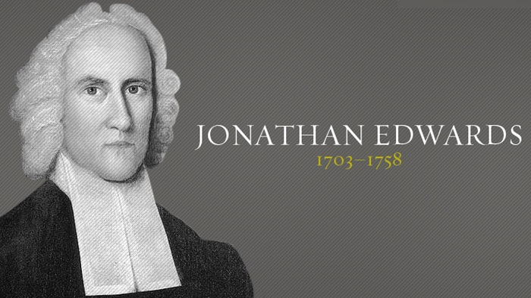
#4 The Foolishness of Christianity
1Corinthians 1:17 – 2:5
mess
y
church

Slide 6
#4 The Foolishness of Christianity
1Corinthians 1:17 – 2:5
mess
y
church
The Foolishness of the cross (v17-25)
The Foolishness of the people God chooses (v26-31)
The Foolishness of Preaching (2:1-5)
Nothing especially dynamic about Paul’s preaching (v1)
Focus was on Jesus (v2)
...and it came with power. (v4)
Christians ought to be humble. Are you?

