Slide 1
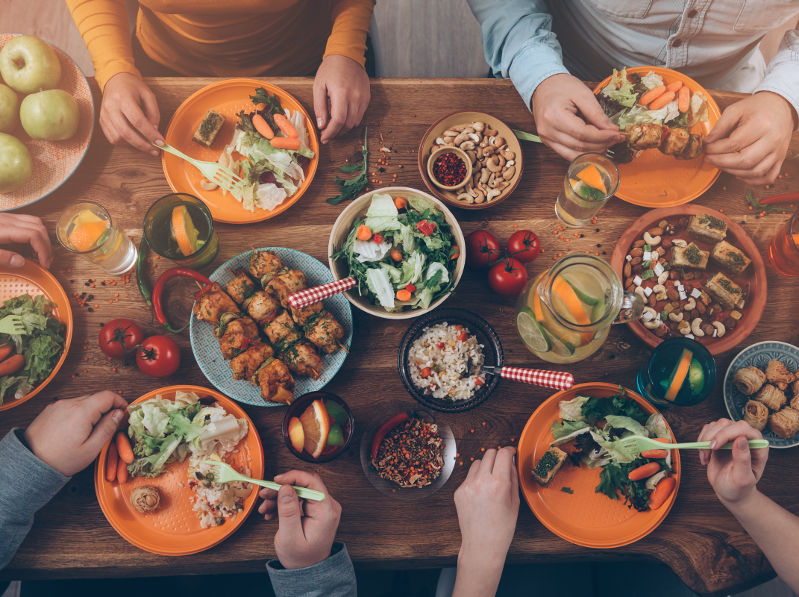
Mealtimes
with the
Messiah
#10 The Last Supper
(Matthew 26:17-30)

Slide 2
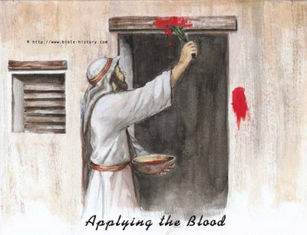
Mealtimes
#10 The Last Supper
(Matthew 26:17-30)
Messiah
with the

Slide 3
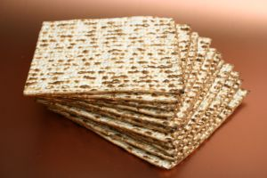
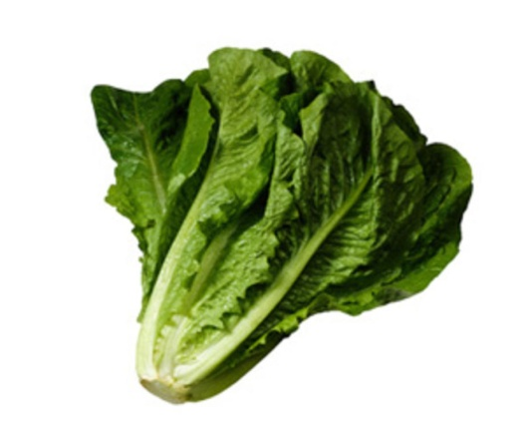
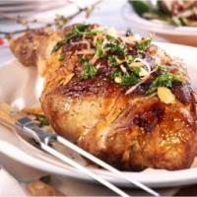
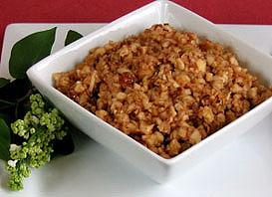
Mealtimes
#10 The Last Supper
(Matthew 26:17-30)
Messiah
with the
PASSOVER
Unleavened bread
Bitter herbs
Roast lamb
Charoset

Slide 4

Mealtimes
#10 The Last Supper
(Matthew 26:17-30)
Messiah
with the
  Exodus 6:6-7: I am the Lord, and I will bring you out from under the yoke of the Egyptians. I will free you from being slaves to them, and I will redeem you with an outstretched arm and with mighty acts of judgment. I will take you as my own people
4 cups of wine = 4 promises

Slide 5
Mealtimes
#10 The Last Supper
(Matthew 26:17-30)
Messiah
with the
PASSOVER
Unleavened bread
Bitter herbs
Wine
Roast lamb
Charoset

Slide 6
Mealtimes
#10 The Last Supper
(Matthew 26:17-30)
Messiah
with the
Unleavened bread
  Isaiah 53:5
  ...he was pierced for our transgressions,
  he was crushed for our iniquities;

Slide 7
Mealtimes
#10 The Last Supper
(Matthew 26:17-30)
Messiah
with the
  Exodus 6:6-7
  ...I will redeem you.

Slide 8
Mealtimes
#10 The Last Supper
(Matthew 26:17-30)
Messiah
with the
  Is he your substitute?
  v20 One of you will betray me...
  2Corinthians 13:5 Examine yourselves to see whether you are in the faith; test yourselves.

