Slide 1

Getting your
Head around
the
Bible
#2 Who decided what’s in there?
Luke 11:45 - 54

Slide 2
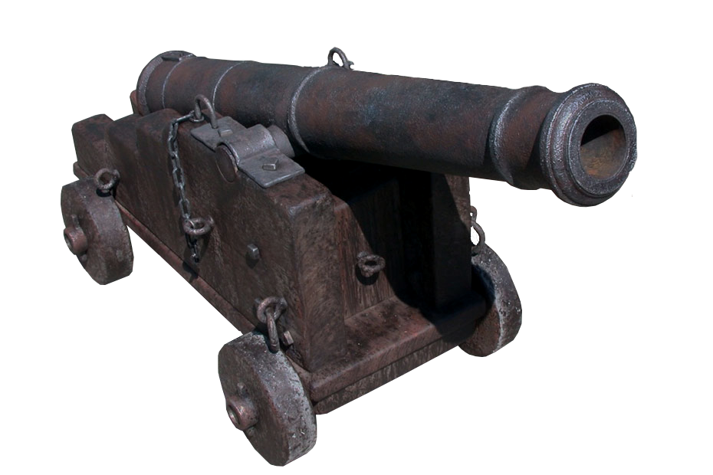
Getting your Head
around the
Bible
#2 Who decided what’s in there?
Luke 11:45-54
Canon:
Measuring rod
Cannon

Slide 3
Getting your Head
around the
Bible
#2 Who decided what’s in there?
Luke 11:45-54
Deuteronomy 32:47…They are not just idle words for you – they are your life.

Slide 4
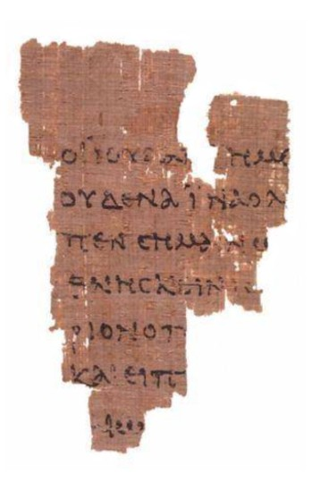
Getting your Head
around the
Bible
#2 Who decided what’s in there?
Luke 11:45-54
Bible = “Books”
New Testament
27 books
Old Testament
39 books
P52
Fragment of John’s gospel
~120AD

Slide 5
Getting your Head
around the
Bible
#2 Who decided what’s in there?
Luke 11:45-54
Law
Genesis
Exodus
Leviticus
Numbers
Deuteronomy
Prophets
Former prophets
Joshua
Judges
Samuel
Kings
Latter prophets
Isaiah
Jeremiah
Ezekiel
The Twelve
Writings
Poetry
Psalms
Proverbs
Job
Five Scrolls
Song of Songs
Ruth
Lamentations
Esther
Ecclesiastes
History
Daniel
Ezra-Nehemiah
Chronicles
Records of Samuel, Nathan, Gad 1Chronicles 29:29
Book of Jashar Joshua 10:13
Book of the Wars of the Lord Numbers 21:14
Annals of Solomon 1Kings 11:41
~20 others mentioned in OT
24 books
...or 39 books!

Slide 6
Getting your Head
around the
Bible
#2 Who decided what’s in there?
Luke 11:45-54
Law
Genesis
Exodus
Leviticus
Numbers
Deuteronomy
Prophets
Former prophets
Joshua
Judges
Samuel
Kings
Latter prophets
Isaiah
Jeremiah
Ezekiel
The Twelve
Writings
Poetry
Psalms
Proverbs
Job
Five Scrolls
Song of Songs
Ruth
Lamentations
Esther
Ecclesiastes
History
Daniel
Ezra-Nehemiah
Chronicles
Luke 11:51 …from the blood of Abel to the blood of Zechariah…
+ Romans 3:2, 2Timothy 3:16
24 books
...or 39 books!

Slide 7
Getting your Head
around the
Bible
#2 Who decided what’s in there?
Luke 11:45-54
Jewish devotional, historical, theological books
New Testament
Translated into Latin
Apocrypha
Gradually accepted as Christian scripture
Rejected by protestants at the Reformation
Old Testament

Slide 8
Getting your Head
around the
Bible
#2 Who decided what’s in there?
Luke 11:45-54
Gospels
Matthew
Mark
Luke
John
History
Acts
Letters
Paul’s letters
Romans
1Corinthians
2Coronthians
Galatians
Ephesians
Philippians
Colossians
1Thessalonians
2Thessalonians
1Timothy
2Timothy
Titus
Philemon
Other
Revelation
Other letters
Hebrews
James
1Peter
2Peter
1John
2John
3John
Jude
27 books

Slide 9
Getting your Head
around the
Bible
#2 Who decided what’s in there?
Luke 11:45-54
Gospels
Matthew
Mark
Luke
John
History
Acts
Letters
Paul’s letters
Romans
1Corinthians
2Coronthians
Galatians
Ephesians
Philippians
Colossians
1Thessalonians
2Thessalonians
1Timothy
2Timothy
Titus
Philemon
Other
Revelation
Other letters
Hebrews
James
1Peter
2Peter
1John
2John
3John
Jude
(Peter)
(?)
(Paul)
(Paul)
(James & Jesus)
Luke 1:1-3 Many have undertaken to draw up an account of the things that have been fulfilled among us, just as they were handed down to us by those who from the first were eye witnesses and servants of the word. With this in mind, since I myself have carefully investigated everything from the beginning, I too decided to write an orderly account for you...
27 books

Slide 10

Getting your Head
around the
Bible
#2 Who decided what’s in there?
Luke 11:45-54
Gospels
Matthew
Mark
Luke
John
History
Acts
Letters
Paul’s letters
Romans
1Corinthians
2Coronthians
Galatians
Ephesians
Philippians
Colossians
1Thessalonians
2Thessalonians
1Timothy
2Timothy
Titus
Philemon
Other
Revelation
Other letters
Hebrews
James
1Peter
2Peter
1John
2John
3John
Jude
27 books

Slide 11
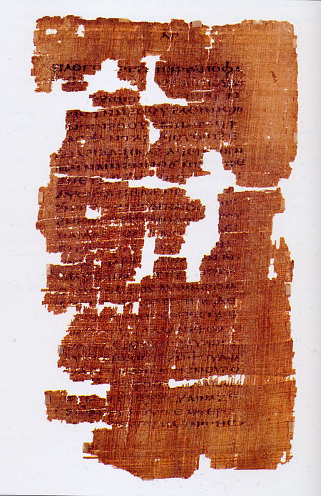
Getting your Head
around the
Bible
#2 Who decided what’s in there?
Luke 11:45-54
So how did they decide what was authentic?
Was it written early enough to be real?
Was the author an apostle?
Is it consistent with known facts?
Is it consistent with the rest of the OT and NT?
Does it glorify Jesus?
Does it speak with the power of God?
✗
✗
✓
✗
✗
✗
Hebrews 4:12 ...the word of God is alive and active. Sharper than any double-edged sword, it penetrates even to dividing soul and spirit, joints and marrow; it judges the thoughts and attitudes of the heart.
John 14:13-14 when he, the Spirit of truth, comes, he will guide you into all the truth. He will not speak on his own; he will speak only what he hears, and he will tell you what is yet to come. He will glorify me because it is from me that he will receive what he will make known to you.
Gospel of Judas

Slide 12
Getting your Head
around the
Bible
#2 Who decided what’s in there?
Luke 11:45-54
What to do with all this?
Treat new discoveries with caution
As far as you can, be a “thinking person”
Have confidence in this book
Read & learn it!
Deuteronomy 32:47…They are not just idle words for you – they are your life.

